Slide 1

REPORT
Digital electronics and logic design
KHADIJA HABBOUBI

Slide 2
Learning Objectives
Electronic Circuit Analysis
Logic Algebra and Simplification
Digital Signal Systems and Binary Systems
Boolean and Gate Logic

Slide 3
1-Electronic Circuit Analysis
Electronic circuit analysis is key to understanding how electrical systems work. Using Ohm’s Law, the relationship between voltage, current, and resistance is established, explaining how circuits behave in series and parallel. Kirchhoff’s Theorems (KCL and KVL) provide tools to analyze circuit currents and voltages systematically.
Simplification methods like the Thevenin and Norton Theorems reduce complex circuits to simpler equivalents, while the Superposition Principle helps analyze circuits with multiple power sources. These principles enable the design, troubleshooting, and optimization of electronic systems.

Slide 4
Content
Ohm’s Law
Kirchhoff's Theorems
Thevenin-Norton Theorem

Slide 5
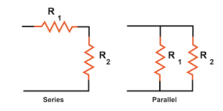
Ohm’s Law
Ohm's Law is a fundamental principle in electrical engineering and circuit analysis that describes the relationship between voltage (V), current (I), and resistance (R) in an electrical circuit. It is mathematically expressed as:
V=I⋅R
Where:
- V is the voltage across the resistor (in volts),
- I is the current flowing through the resistor (in amperes),
- R is the resistance of the resistor (in ohms).

Slide 6
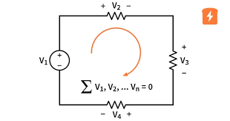
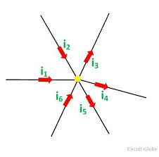
Kirchhoff's Theorems
  KCL: The total current entering and leaving a node equals zero.
  KVL: The sum of potential differences (voltage) in a closed loop equals zero.
  Introduces the lumped circuit model, an idealized representation where all parameters (e.g., resistance, reactance) are concentrated at discrete points.
  Discusses the validity and potential misjudgments of Kirchhoff's laws due to testing equipment errors.

Slide 7
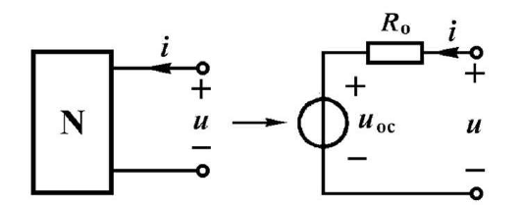
Thevenin-Norton Theorem
  Any linear circuit can be simplified into an equivalent voltage source with a series resistance (Thevenin) or a current source with a parallel resistance (Norton).
  Explains source transformation techniques for simplifying circuit analysis.
  Applications include using the Superposition Principle, where the effect of each power source is analyzed independently.

Slide 8
2-Logic Algebra and Simplification
Digital systems process discrete signals, often converted from analog using ADCs. The binary system represents data as 0s and 1s, corresponding to voltage levels, simplifying data storage and transmission.
Binary data is transmitted via serial (bit-by-bit) or parallel (all bits simultaneously) methods. Operations like binary addition and subtraction, along with coding systems like BCD and ASCII, enable efficient data processing and communication. Binary logic is the backbone of modern digital technology.

Slide 9
Content
Binary Logic Variables and Operations
Compound Logic Operations
Logical Functions and Representations

Slide 10
Content
Fundamental Theorems and Rules of Logical Algebra
Simplification of Logical Functions
Karnaugh Maps

Slide 11
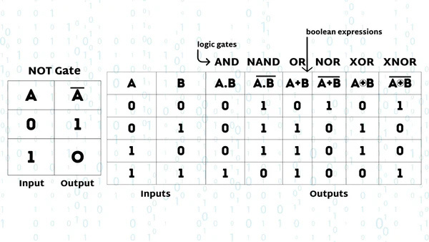
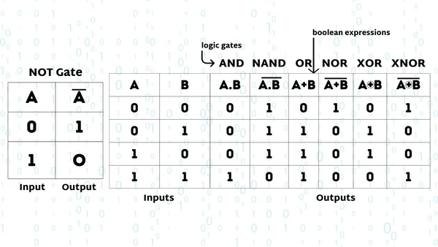
Binary Logic Variables and Operations
  Logic algebra operates on binary variables (0 and 1) to represent logical states. Key operations include:
  AND (·): Output is 1 only when both inputs are 1.
  OR (+): Output is 1 when any input is 1.
  NOT (¬): Inverts the input (0 becomes 1, and 1 becomes 0).

Slide 12
Compound Logic Operations
  NAND: Inverts the output of AND.
  NOR: Inverts the output of OR.
  XOR: Output is 1 when inputs differ.
  XNOR: Output is 1 when inputs are the same.

Slide 13
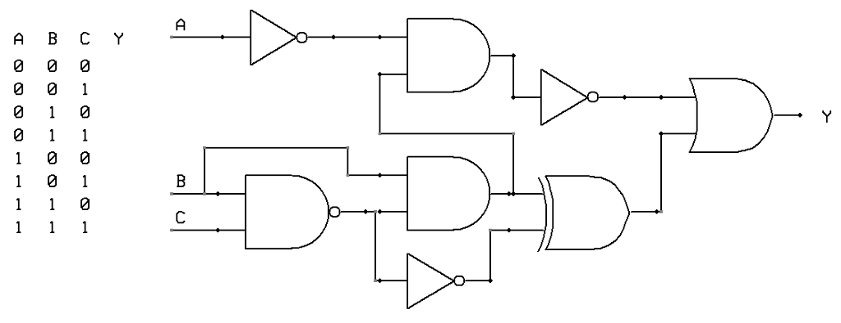
Logical Functions and Representations
  Truth Tables: Show output for all input combinations.
  Logical Expressions: Use algebra to express relationships
(e.g., L=AB+BC).
  Logical Diagrams: Represent functions using logic gates (AND, OR, NOT).
  Waveform Diagrams: Display time-based signal outputs.

Slide 14
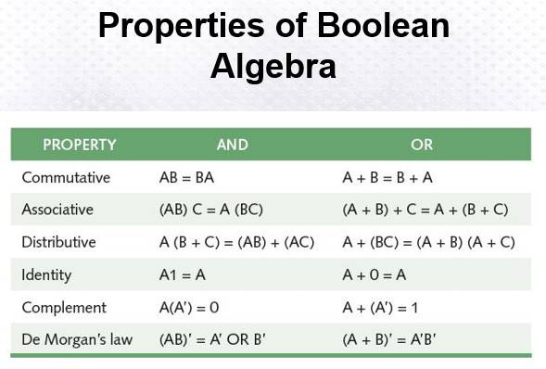
Fundamental Theorems and Rules of Logical Algebra
  Laws:
  Commutative: A+B=B+A
  Associative: (A+B)+C=A+(B+C)
  Distributive: A(B+C)=AB+AC
  Simplification Rules: Use algebraic laws to simplify logic expressions.

Slide 15
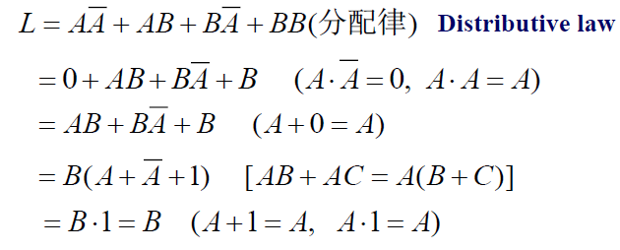
Simplification of Logical Functions
  Algebraic Method: Apply laws like distributive and absorption to reduce expressions.
  Karnaugh Map: A graphical method to simplify logic functions by grouping adjacent 1s.

Slide 16
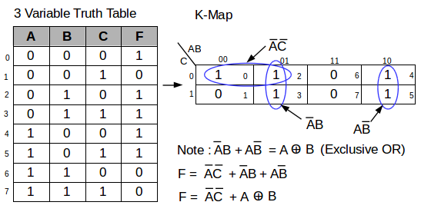
Karnaugh Maps
  Visualize all min terms of variables in a grid.
  Group logically adjacent terms to simplify functions.
  Examples: Two-variable, three-variable, and four-variable maps.

Slide 17
3-Digital Signal Systems and Binary Systems
Digital systems process discrete signals, often converted from analog using ADCs. The binary system represents data as 0s and 1s, corresponding to voltage levels, simplifying data storage and transmission.
Binary data is transmitted via serial (bit-by-bit) or parallel (all bits simultaneously) methods. Operations like binary addition and subtraction, along with coding systems like BCD and ASCII, enable efficient data processing and communication. Binary logic is the backbone of modern digital technology.

Slide 18
Content
Introduction to Digital and Analog Signals
Binary Systems
Binary Data Transmission

Slide 19
Content
Conversions Between Decimal and Binary
Binary Arithmetic Operations
Binary Codes

Slide 20
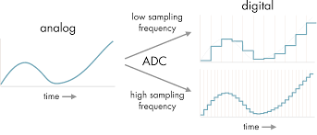
Introduction to Digital and Analog Signals
  Analog Signals: Continuous in time and value (e.g., sine waves).
  Digital Signals: Discrete in time and value, easier to store, analyze, and transmit.
  Analog-to-Digital Conversion (ADC): Converts continuous signals to discrete digital signals using techniques like sampling and quantization.

Slide 21
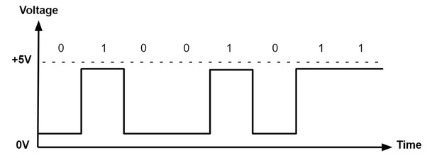
Binary Systems
  Binary logic uses 0 and 1 to represent states.
  Logic levels correspond to voltage values (e.g., +5V for logic 1 and 0V for logic 0).
  Digital waveforms represent binary values graphically over time.

Slide 22
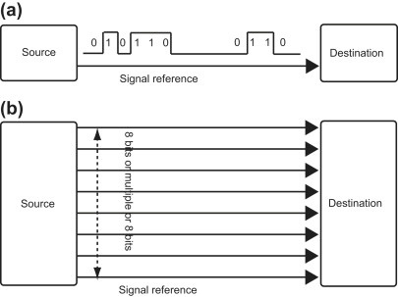
Binary Data Transmission
  Serial Transmission: Sends data bits sequentially, requiring fewer lines but slower transmission.
  Parallel Transmission: Sends all bits simultaneously, offering faster transmission but requiring more lines and complex hardware.

Slide 23
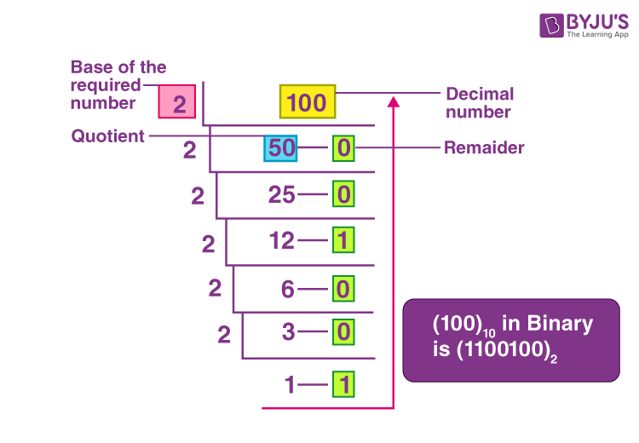
Conversions Between Decimal and Binary
  Integer Conversion: Use the "divide by 2" method until the quotient is 0, then reverse the remainders.
  Fractional Conversion: Multiply the fractional part by 2 iteratively, recording the integer parts until the desired precision is reached.

Slide 24
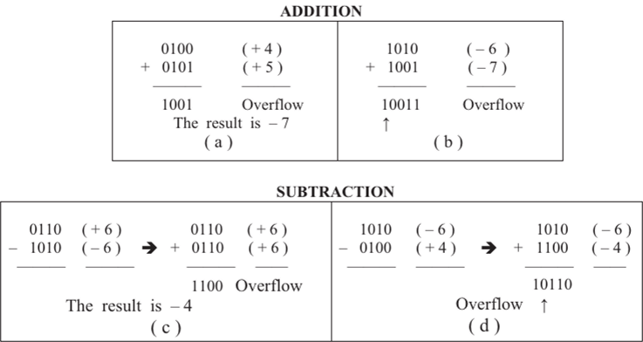
Binary Arithmetic Operations
  Unsigned Binary: Basic addition and subtraction with carry or borrow.
  Signed Binary: Uses the most significant bit as the sign (0 for positive, 1 for negative).
  Complement Codes: Enable arithmetic operations with negative numbers by flipping bits and adding 1.
  Overflow occurs when results exceed the bit limit and can be resolved through bit expansion.

Slide 25
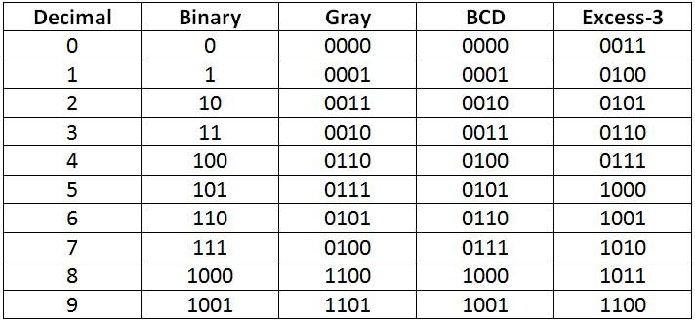
Binary Codes
  BCD Codes: Represent decimal digits in binary (e.g., 8421 and 2421 codes).
  Gray Codes: Designed for minimal transition between states, where only one bit changes between consecutive numbers.
  ASCII: Encodes characters into binary for use in digital systems (e.g., keyboards).

Slide 26
4-Boolean and Gate Logic
The brain of any computer is the CPU (central processing unit). The CPU fetches instructions from main memory and executes them.
The ALU (arithmetic logic unit) is the component within the CPU where logical decisions are made. This decision making process is called Boolean logic.

Slide 27
Content
Understand the role of Boolean logic in computer systems
Identify common logic gates: AND, OR, NOT, XOR
Interpret truth tables for logic gates and logic circuits

Slide 28
Logic Gates
Boolean logic is represented using logic gate symbols.
Logic gates use Boolean logic to take one or more binary inputs and produce a single binary output.

Slide 29
Input | Input | Output
A | B | Q
0 | 0 | 0
0 | 1 | 0
1 | 0 | 0
1 | 1 | 1
AND Gate
A
Q
B
Both inputs must be true for a true output.

Slide 30
Input | Input | Output
A | B | Q
0 | 0 | 0
0 | 1 | 1
1 | 0 | 1
1 | 1 | 1
OR Gate
A
Q
B
Only one needs to be true for a true output.

Slide 31
NOT Gate
Input | Output
A | Q
0 | 1
1 | 0
A
Q
A single input is reversed for a single ouput.

Slide 32
Input | Input | Output
A | B | Q
0 | 0 | 0
0 | 1 | 1
1 | 0 | 1
1 | 1 | 0
XOR Gate
A
Q
B
Only one input can be true for a true output.

Slide 33
Logic Circuits
Input | Input | Output
A | B | Q
0 | 0 | 1
0 | 1 | 0
1 | 0 | 0
1 | 1 | 0
Multiple logic gates can be combined to create a logic circuit. In this example, the output of the OR gate is reversed through the NOT gate.
A
Q
B

Slide 34
A | B | C | D | E | Q
0 | 0 | 0 | 1 | 0 | 0
1 | 0 | 0 | 0 | 0 | 0
1 | 1 | 0 | 0 | 0 | 0
1 | 1 | 1 | 0 | 0 | 1
0 | 0 | 1 | 1 | 0 | 1
0 | 1 | 1 | 1 | 1 | 0
1 | 0 | 1 | 0 | 0 | 1
0 | 1 | 0 | 1 | 1 | 1
Logic Circuits
D
A
E
Q
B
C

